Slide 1
Argumentation in NLP
http://www.ixa.eus/iltapp/
@ragerri @joseba_fdl @iker_garciaf #iltapp
(partially based on ACL 2016 tutorial)

Slide 2
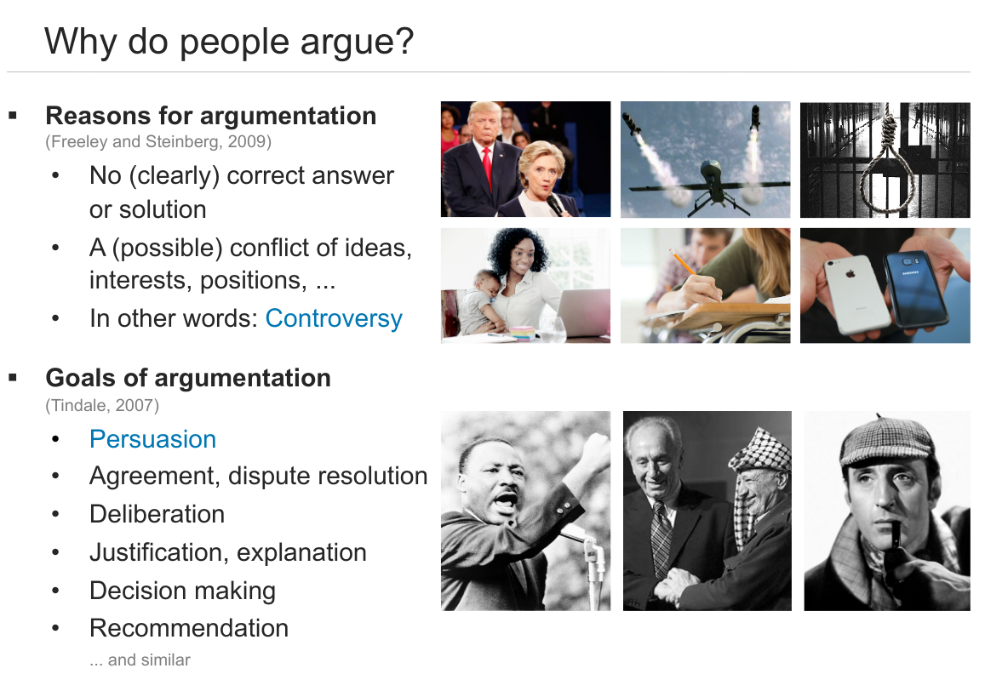

Slide 3
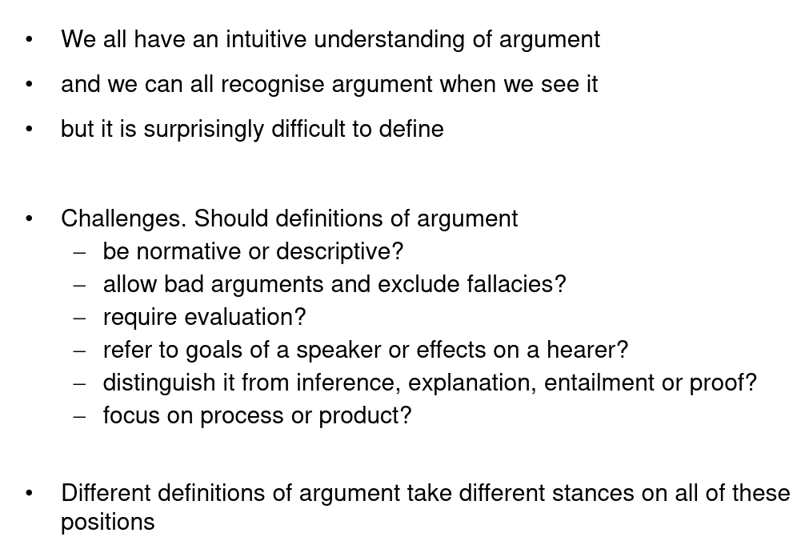
Argument - Intuition

Slide 4
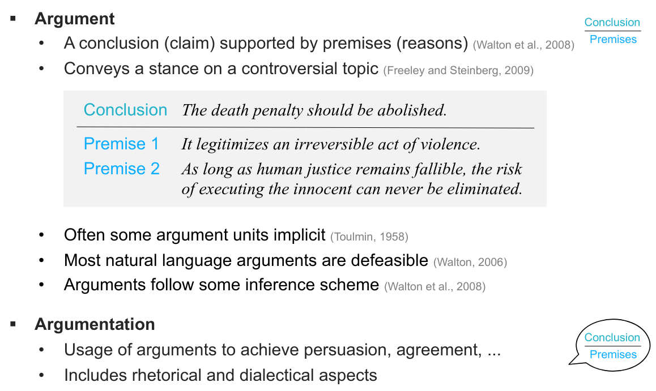
Arguments and Argumentation

Slide 5
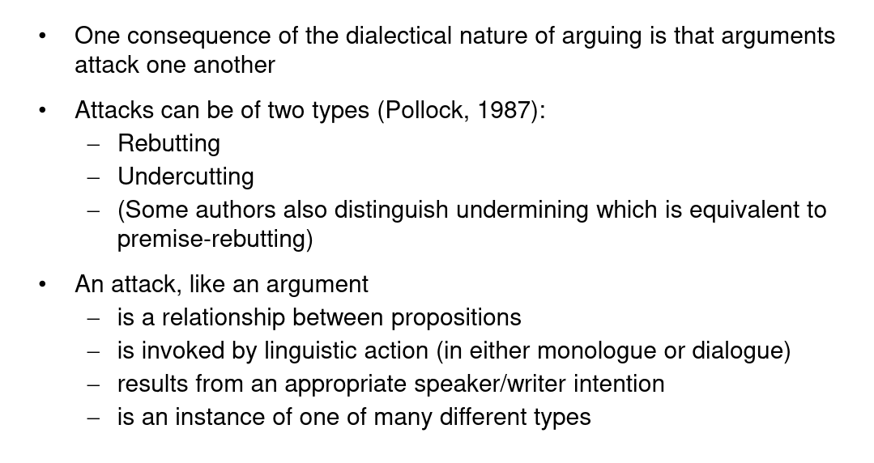
Arguing and attacking

Slide 6
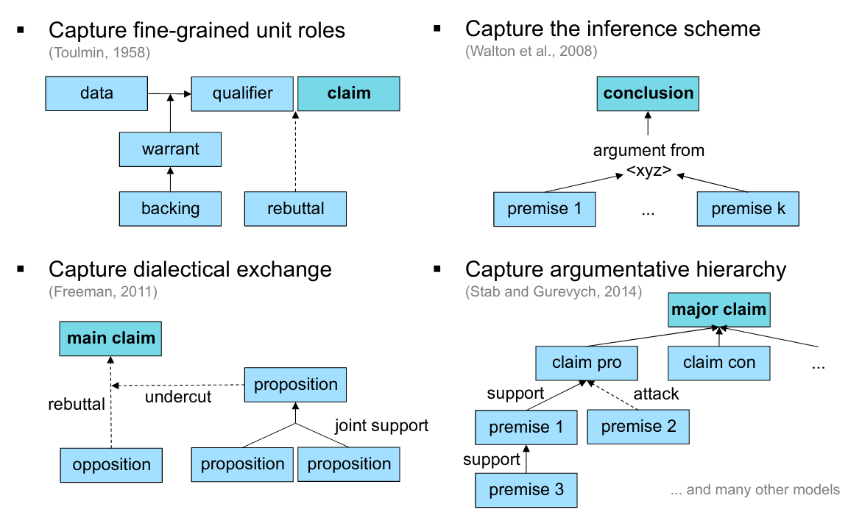
A variety of models

Slide 7
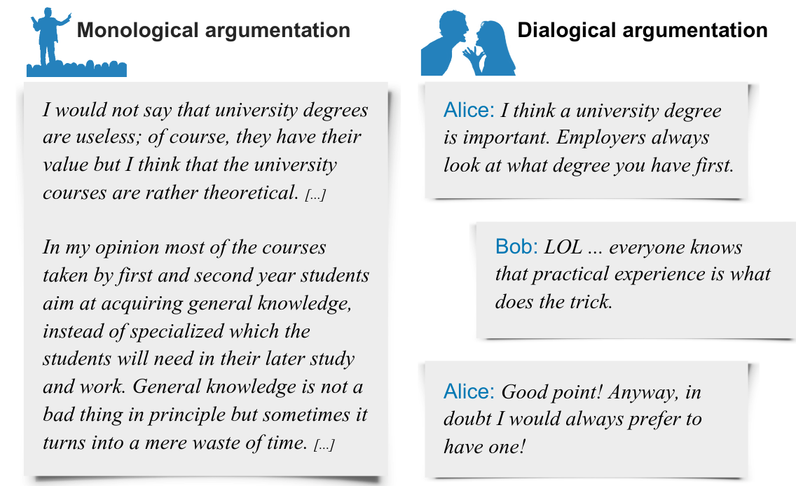
Monological and Dialogical

Slide 8
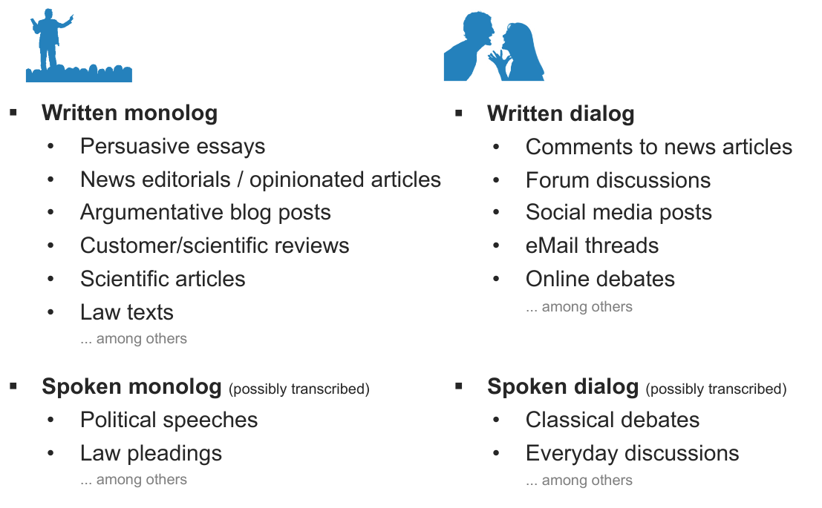
Genres

Slide 9
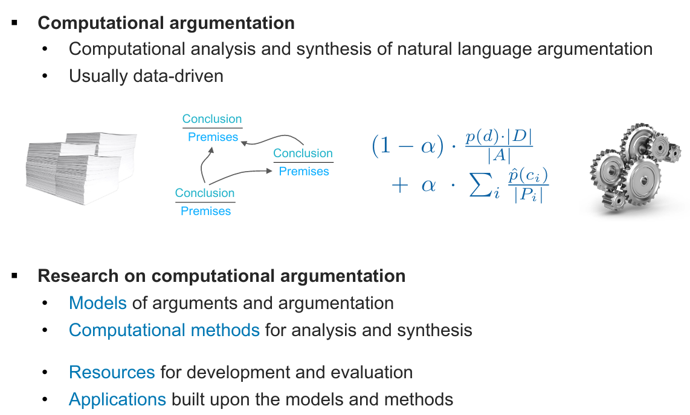
Argumentation in NLP

Slide 10
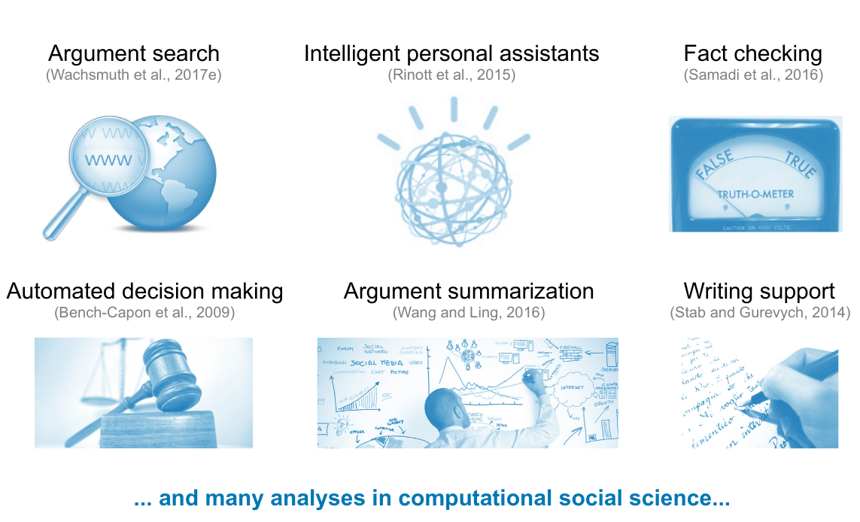
Applications

Slide 11
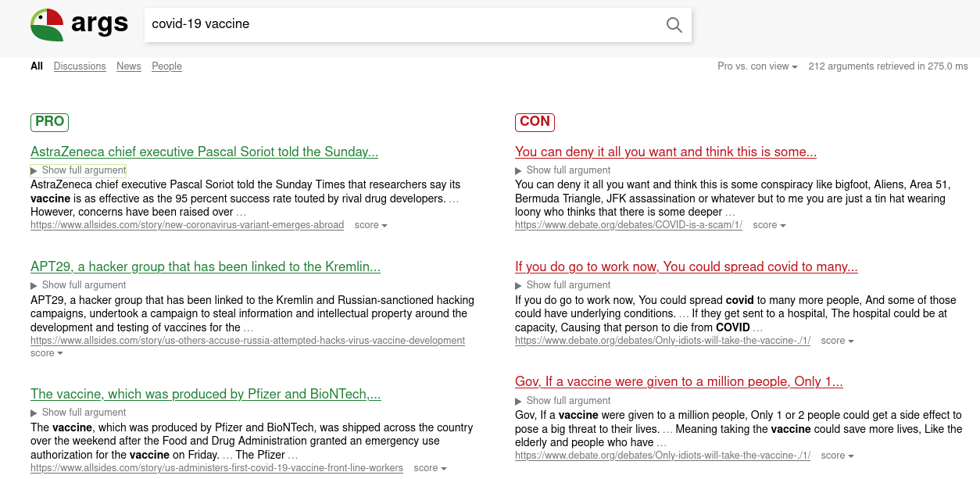
Argument Search - https://www.args.me

Slide 12
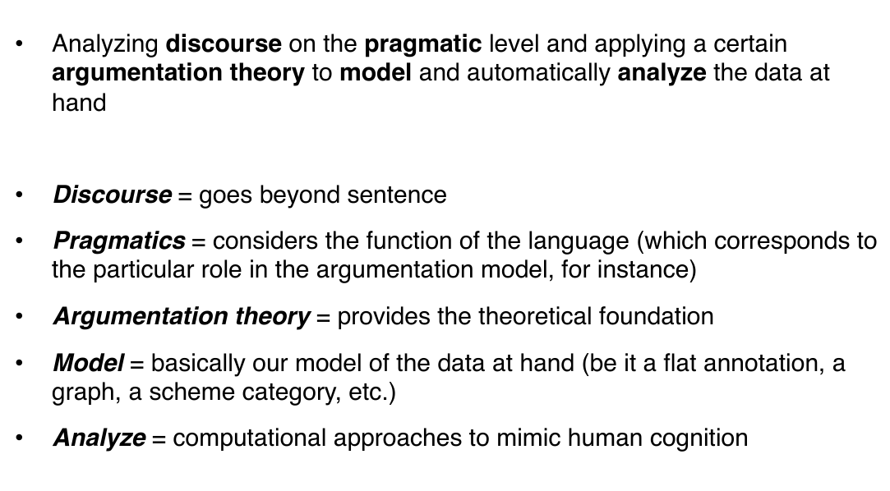
Argument Mining

Slide 13
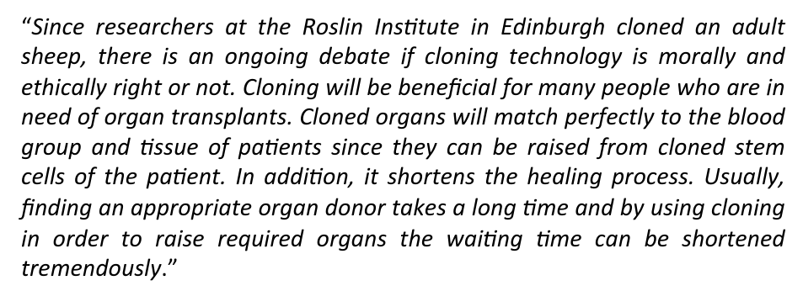
Argument Mining - Example

Slide 14
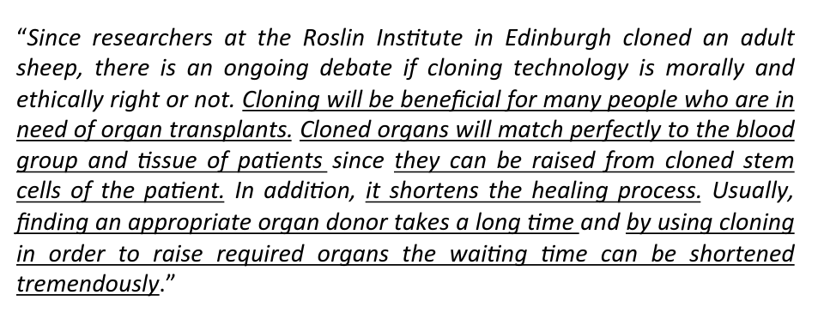
Argument Mining - Example
Segmenting Texts into Argumentative Units

Slide 15
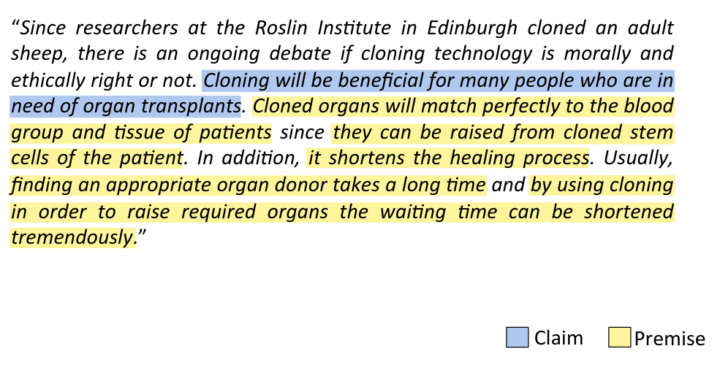
Argument Mining - Example
Example: Classifying Types of Units

Slide 16
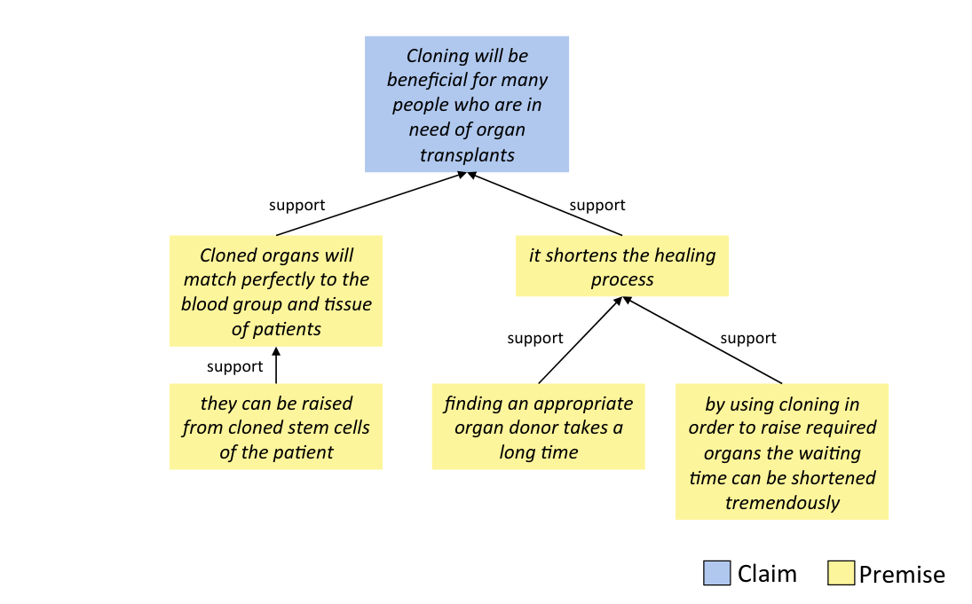
Argument Mining - Example
Example: Identifying Relations between Units

Slide 17
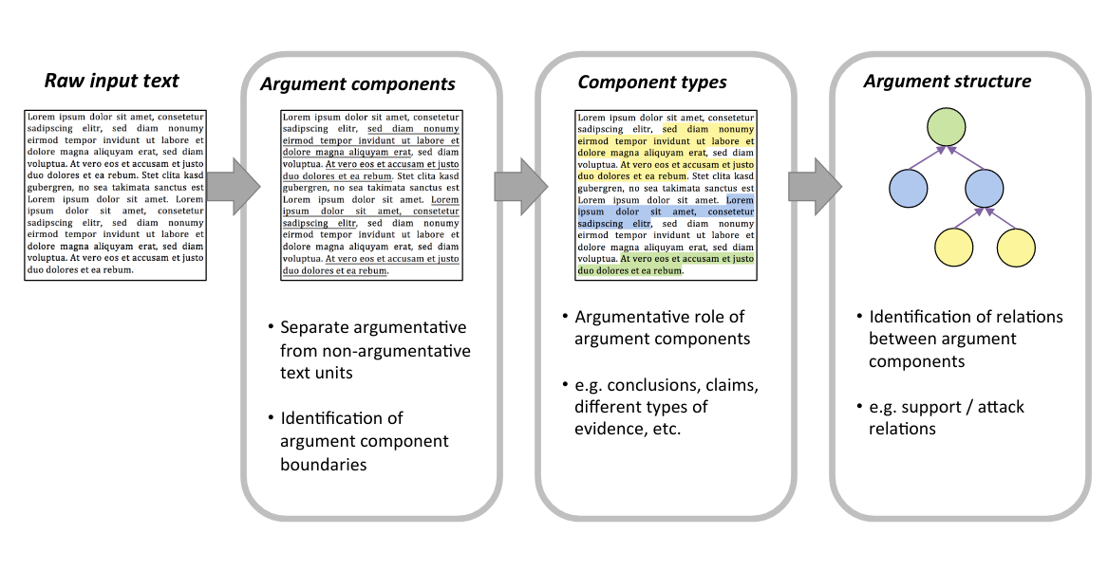
Argument Mining - Task Overview

Slide 18
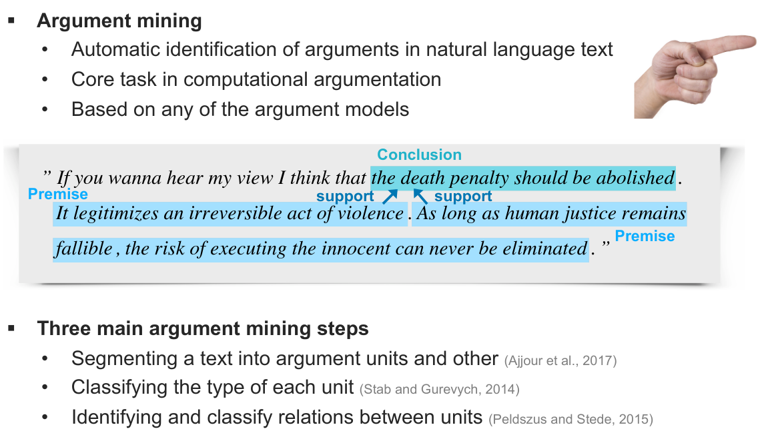
Argument Mining - Task Overview

Slide 19
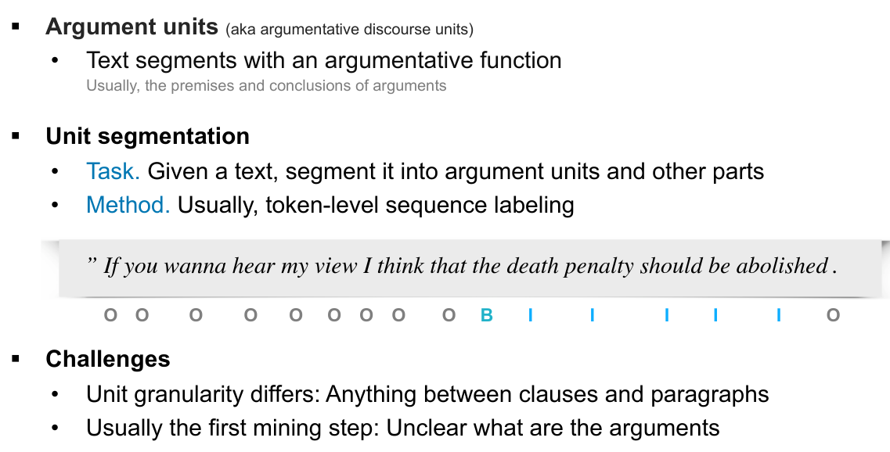
Argumentative Units

Slide 20
Argumentative Units

Slide 21
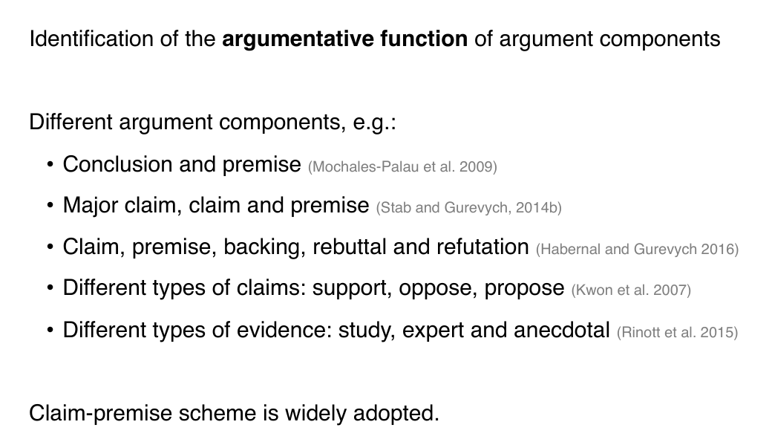
Classifying Types of Units

Slide 22
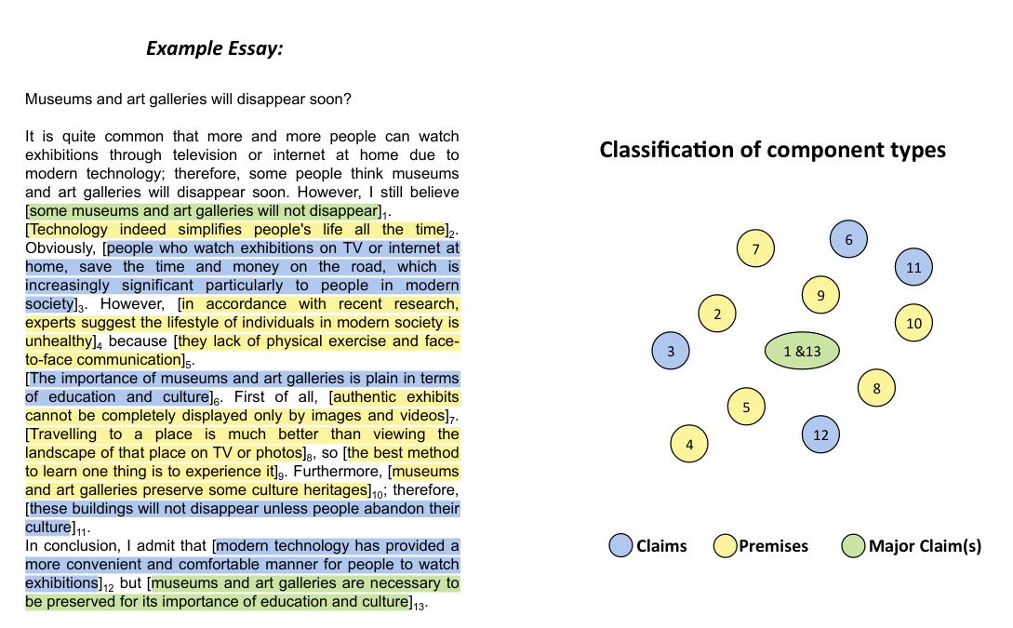
Classifying Types of Units

Slide 23
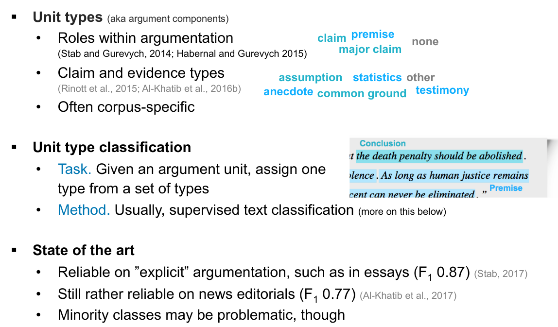
Classifying Types of Units

Slide 24
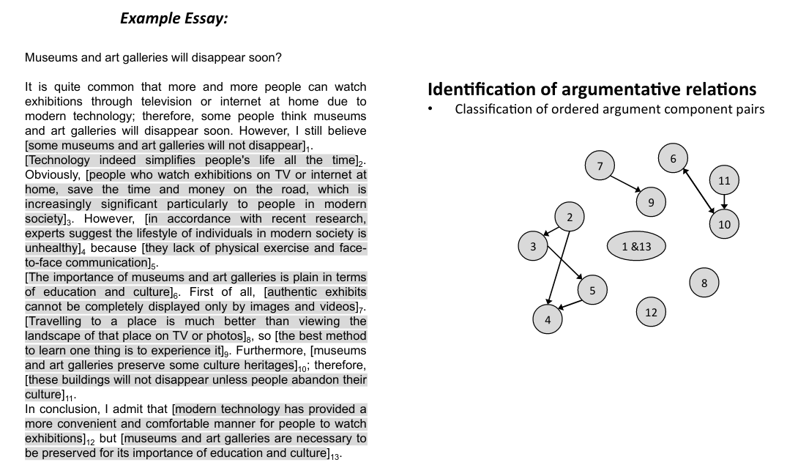
Relation Classification

Slide 25
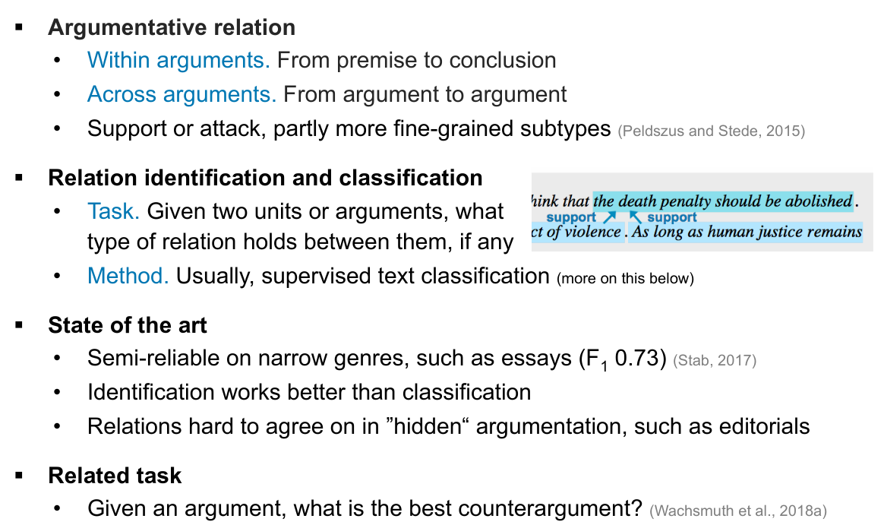
Relation Classification

Slide 26
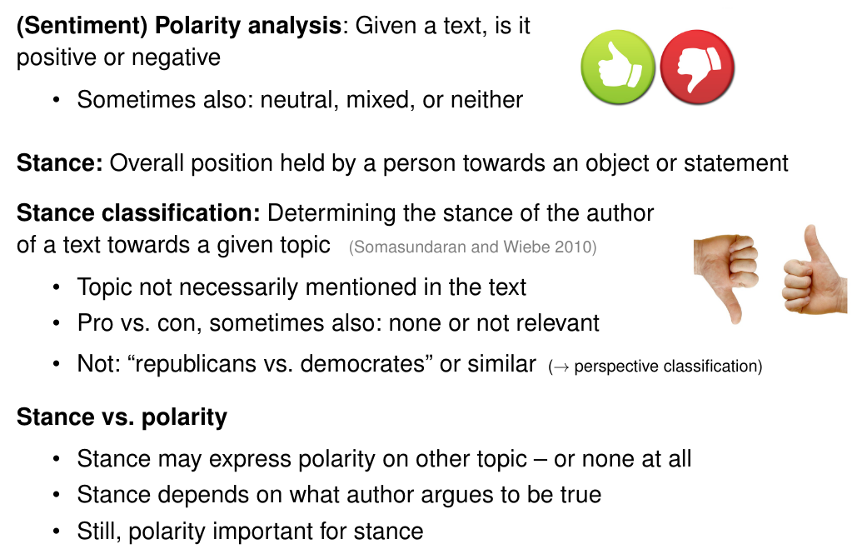
Stance Detection and Polarity

Slide 27
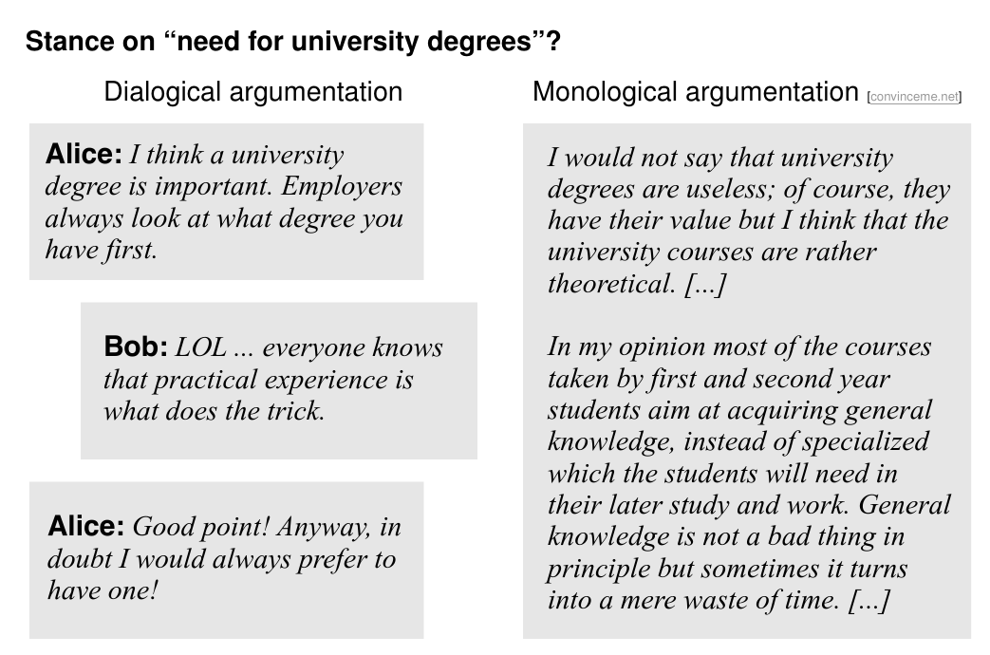
Stance Detection and Argumentation

Slide 28
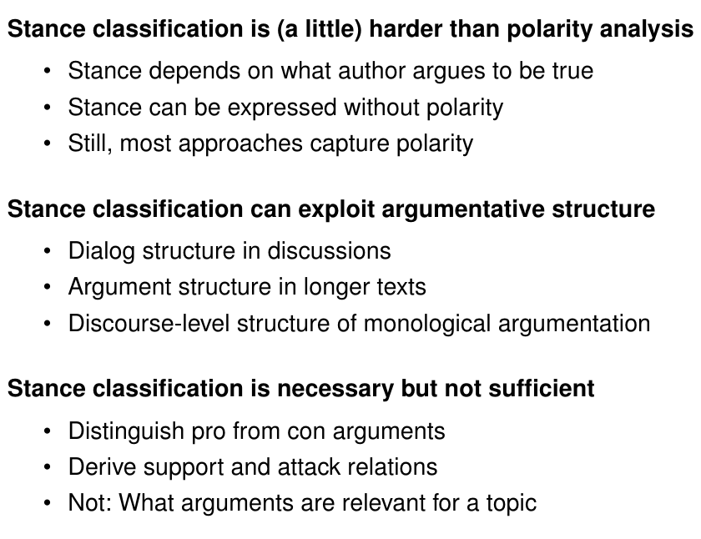
Stance Detection and Argumentation

Slide 29
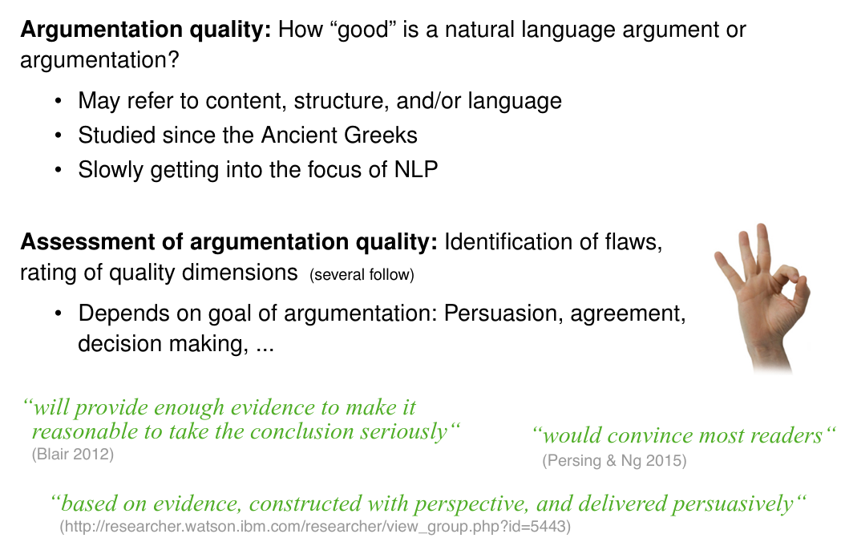
Argument Quality

Slide 30
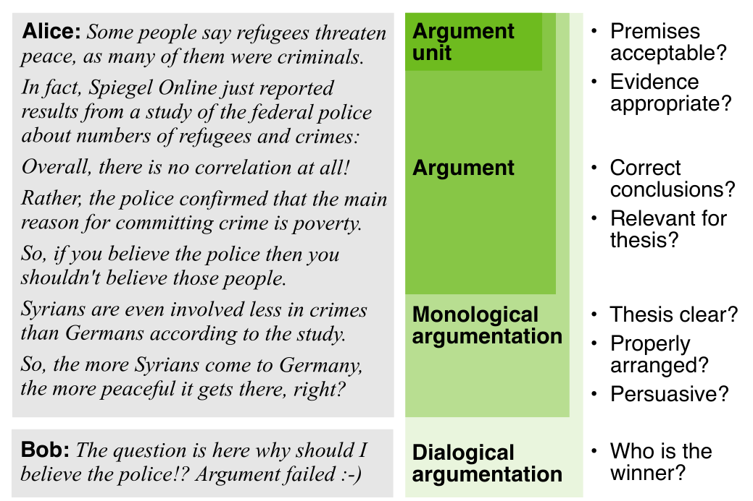
Argument Quality

Slide 31
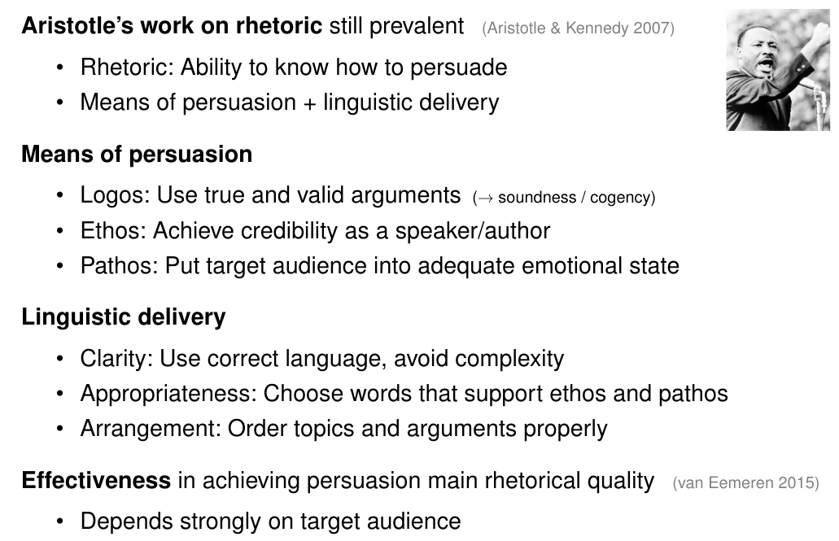
Argument Quality and Persuasion

Slide 32
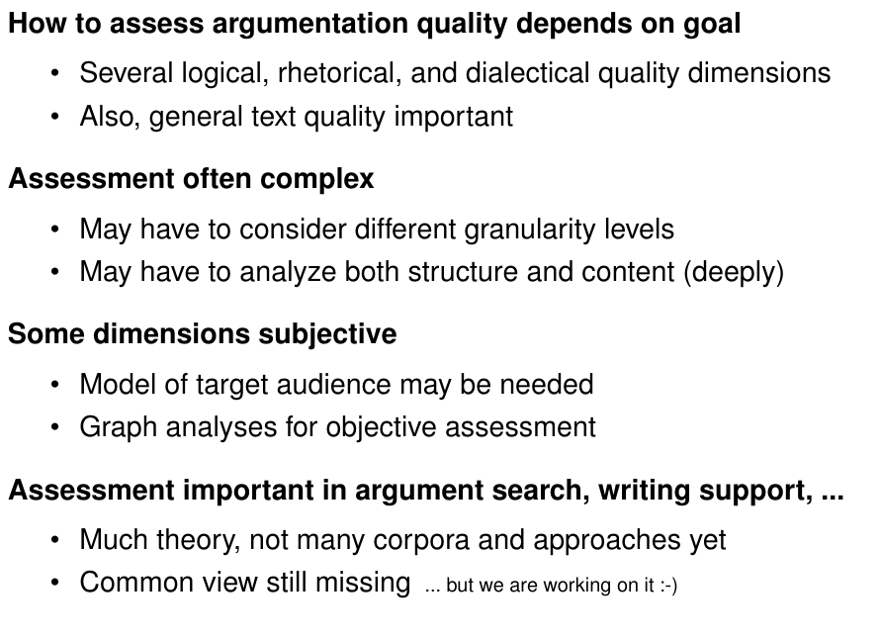
Argument Quality - Overview

Slide 33
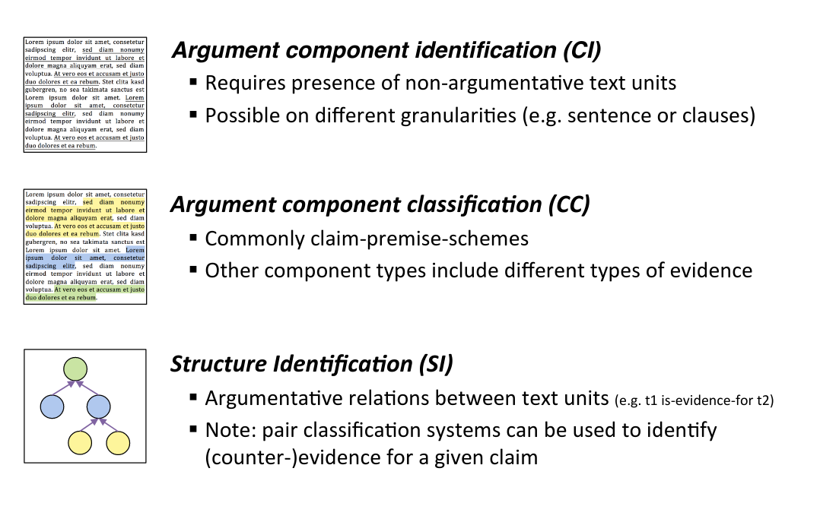
Resources

Slide 34
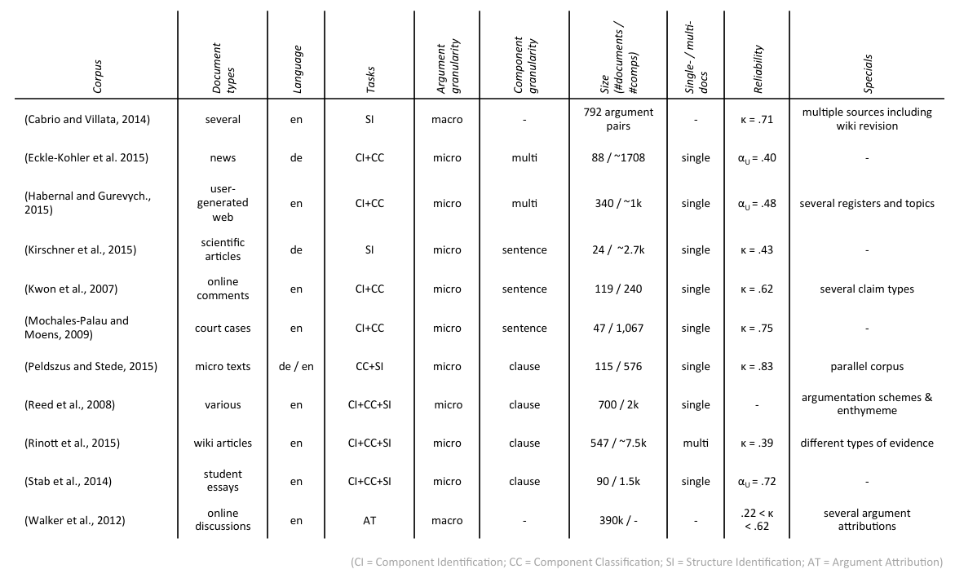
Resources

Slide 35
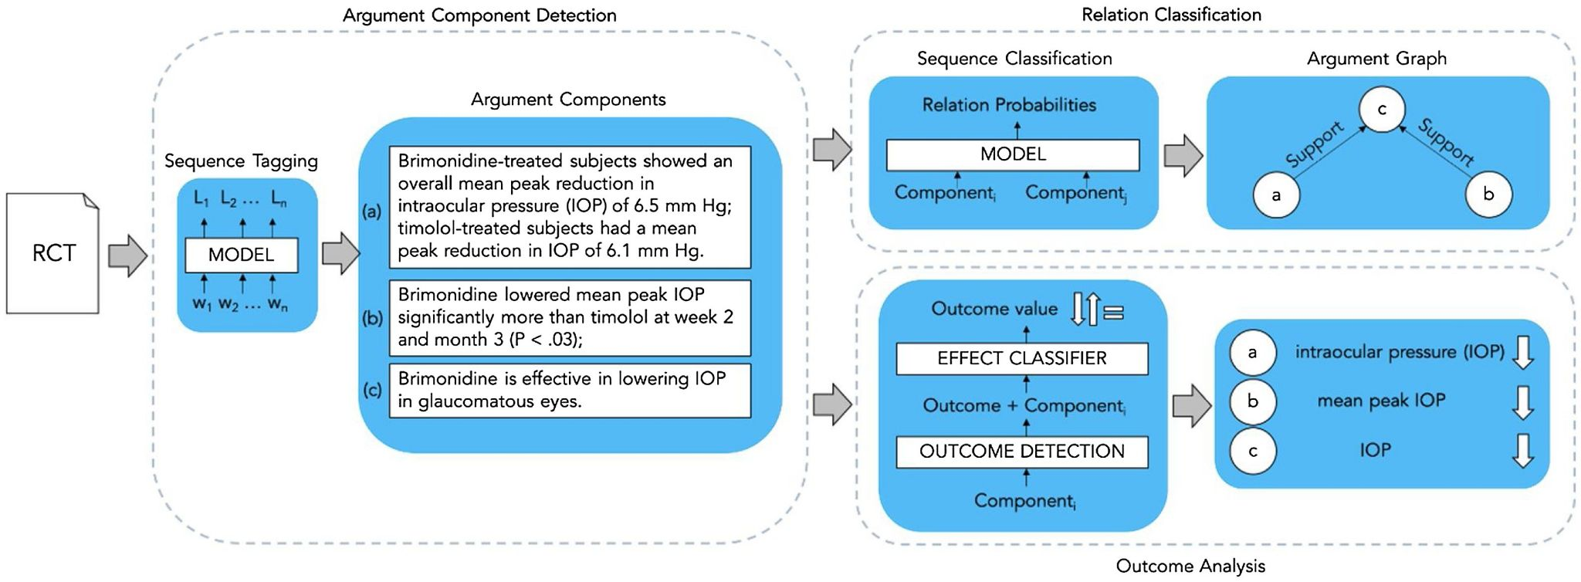
Resources
ANTIDOTE https://univ-cotedazur.eu/antidote
Abstrct dataset - Argumentation in clinical trials

Slide 36
Lab Time!
[8. Finetune DistilBERT for Argument Mining]
Edited from Huggingface notebooks
You will find notebooks for sequence labeling, language modeling....
Test the model and check the results with respect to the Abstrct paper
DistilBERT vs mBERT
DistilBERT vs XLM-RoBERTa
Next lab we will show how to build a model to generate arguments against hate speech
Test your the NLG model by entering your own hate speech... (DISCLAIMER: no hate speech condoned).

